Slide 1


Forces & Vehicle Safety
Maisum Syed

Slide 2
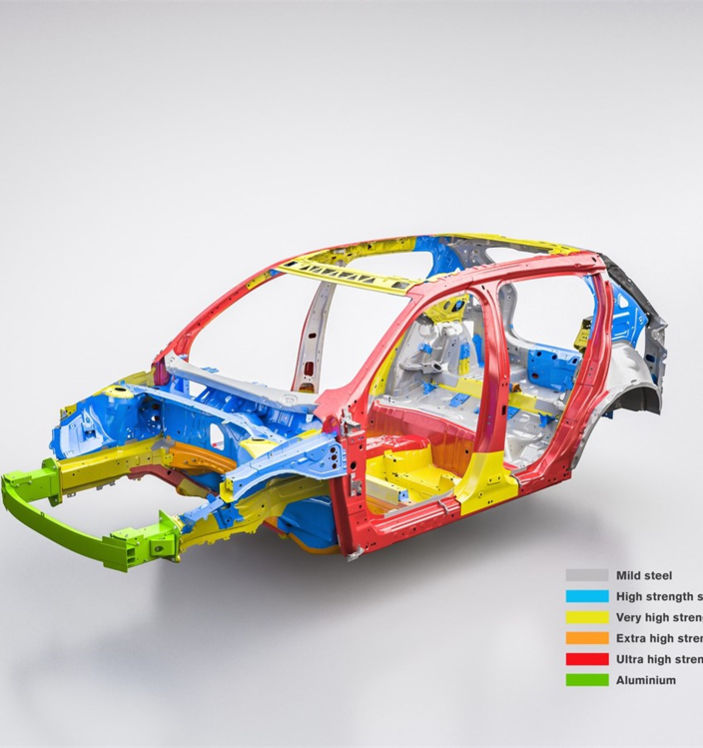
Increasing the time of the collision or the time the occupants take to stop
Any transportation structure must include crumple zones since they are utilised to absorb kinetic energy during collision situations. As a result, there will be fewer fatalities among the people in the cabin. Crumple zones function similarly to the cardboard boxes used in stunts in movies to stop a fall. The stuntman generates kinetic energy as he descends; if he were to reach solid ground, the majority of that energy would be quickly absorbed by his body, perhaps with disastrous results. However, a well-planned stunt will make sure that the stuntman falls on a stack of boxes, which will cause the boxes to collapse rather than injure the stuntman. Similar to this, the goal of crumple zones on cars is to reduce the amount of crash energy that is delivered to the occupants after a collision with a solid object. According to Newton's Second Law of Motion, force is equal to mass times acceleration. In other words, if acceleration and force are proportional, then when acceleration is half, so too will be the strength of the force. Crumple zones are consequently intended to lessen the rate of deceleration of a vehicle, which in turn lessens the force applied to the vehicle. The magnitude of deceleration is correspondingly reduced because of how crumple zones collapse, which also lengthens the time it takes for a car to come to a complete stop.

Slide 3
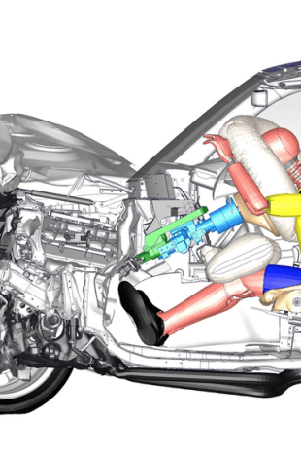
Spreading the forces of impact over the largest possible area & ensuring stability of the vehicle.
Crumple zones enable the front of the car to collapse like an accordion, absorbing part of the shock and releasing it as heat and noise. The front of the car effectively works as a cushion that reduces the force that must be applied to the occupants during a complete stop, perhaps saving their lives. The goal is to direct the force that is generated during an impact away from the occupants. Everyone within the automobile at the moment of the collision and everything that happens to it both use some of the force. Consider the amount of force required to bend a car's steel frame. This amount of force is never transferred to the passengers since it is used to bend the frame. On this idea are based crumple zones. Unique internal structures that are developed to withstand damage, crumpling, crushing, and breaking are used in the construction of many automotive parts. The essential premise is that harm to them requires force. Crumple zones exert the same amount of force
Force is equal to mass times acceleration.The force is reduced by halves the deceleration. Therefore, a 75 percent reduction in total force will come from reducing the deceleration period from.2 seconds to.8 seconds.Crumple zones achieve this by establishing a buffer zone around the car's exterior. The engine and passenger area of an automobile are examples of parts that are stiff and resistant to deforming by nature. Those stiff components will decelerate fast and with a great deal of force if they collide with something. Crumple zones around those components enable the less rigid materials to withstand the first blow. As soon as the crumple zone begins to crumple, the automobile starts to slow down, adding a few extra tenths of a second to the deceleration.
Your car's stability will be improved during turns and emergency manoeuvres thanks to a lowered suspension. greater aerodynamics. Less air is flowing below the automobile when it is lowered, which might lessen the drag placed on the vehicle. enhanced handling

Slide 4
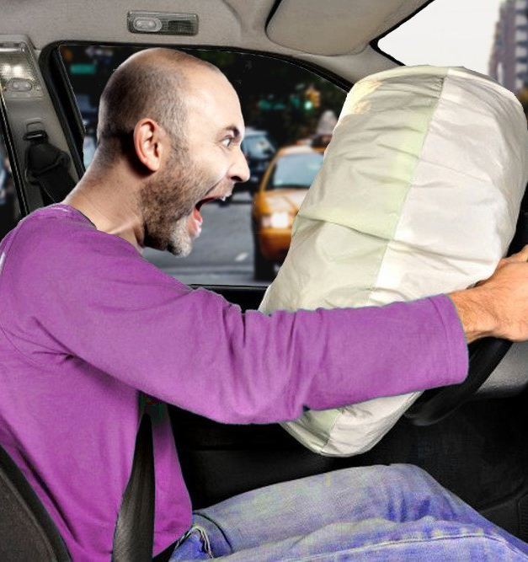
Minimizing contact of the person with the interior of the vehicle
Since 1998, front airbags have been a requirement for all new vehicles, and since 1999, for light trucks. Even before then, the majority of cars had them. When a frontal collision occurs, crash sensors linked to an onboard computer identify it and activate the airbags. The bags quickly expand—in the blink of an eye—before beginning to deflate.Even though airbags have saved many lives, they may potentially harm or even kill youngsters or passengers who aren't wearing seatbelts. Rear-facing child seats should never be fitted in front seats with airbags, and children under the age of 12 should always ride in the back in the proper restraint system.
Your head, neck, and chest areas are all protected by airbags. They erupted from the dashboard or the steering wheel within moments after the impact. When the airbag and the driver collide, the airbag begins to slowly deflate, allowing the driver to safely exit the vehicle without being trapped. In some vehicles, the airbags will activate once the speed reaches 200–300 mph. (5)When the automobile collides, a crash sensor detects it and sends a signal to the control module to inflate the airbag. Most of these sensors are tiny accelerometers, which can detect the impact's deceleration accurately. Only if the impact is severe enough will these cause the air bags to deploy.
A person who is not wearing a seatbelt during a collision will keep moving forwards at the same speed as the car until anything stops them. This may be the dashboard, windscreen, or steering wheel. In certain collisions, the individual may break a glass and be partially or completely ejected from the car, putting them in risk elsewhere. They could run into stationary objects, be ran over by their own car or another one, or get crushed. The force with which an unrestrained occupant impacts the airbag might result in catastrophic injuries even if the vehicle is equipped with an airbag.

Slide 5
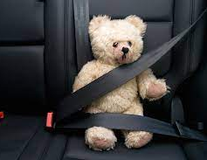
In the event of an accident, seat belts prevent you from tossing around within the vehicle. The seat belts lock into position when they detect a collision. According to Newton's First Law, the individual is not subject to an imbalanced force when the automobile crashes, therefore they continue moving ahead. A force is applied to the seat belt as the individual pushes against it. The individual is then subjected to force from the seat belt (Newton's Third Law). This results in a person's controlled deceleration.Seat belts stop you tumbling around inside the car if there is a collision. Upon sensing a collision the seat belts lock in place. When the car crashes, there is no unbalanced force acting on the person, so they continue forward (Newton's First Law). The person moves against the seat belt, exerting a force on it. The seat belt then exerts a force back on the person (Newton's Third Law). This causes a controlled deceleration of the person

Slide 6
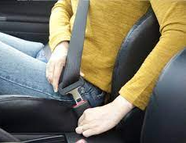
Keeping the person inside the vehicle
Seat belts are related to Newton's Second Law since it asserts that larger forces result in greater acceleration, whereas bigger masses result in less acceleration. It goes without saying that a seat belt prevents you from accelerating. If you were in a vehicle accident and were hit hard, you would accelerate more quickly, but the seat belt would prevent you from doing so. Have you ever heard the belief that if a tissue box sits on a car's back dashboard, it will suddenly stop? The tissue box, which might pierce a person's head, flew from the rear dashboard forwards and towards the front of the vehicle. For the force of the tissue box to punch a hole in a person's head, the automobile would have needed to be travelling at a higher speed. Because the automobile was travelling at a faster speed when it came to a halt, the force of the car stopping caused the tissue box to fly forwards, which is connected to Newton's Second Law and seat belts. Without a seat belt, whether in the front or rear seat, you will speed forwards and collide with whatever is in front of you. So, regardless of your age, always buckle up. Oh, and I wouldn't leave a tissue box on your rear dashboard if I were you. A car moves with inertia, which is an object's tendency to move until something works against the motion of that object. When the vehicle hits something, or is hit by something, that inertia changes

Slide 7
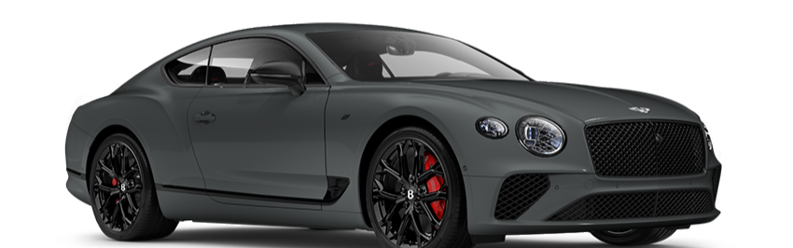
2022 Bentley Continental GT
There are many features of the Bentley continental GT. Firstly, there are many airbags that help reduce the contact of the person with interior objects. There are many airbags, in the knee area, A,B pillars, steering wheel etc. These increase effectiveness of the airbags and make the interior safer for occupants. Secondly, the car has modern design with crumple zone in the front. It is smartly designed to absorb a lot of energy when the car crashes and there is an impact. The more energy absorbed by the frame and crumple zone, the less enery the occupants receive. This makes the car safer. The car is also low to the ground and has many electronic systems and a dedicated computer for the suspension and traction control, drive modes etc. This makes the car stable and less likely to get out of control. The various systems like ABS, ESC etc make sure the car adapts to the weather conditions as well as the road’s, to ensure it is the most stable for the situation.

Slide 8
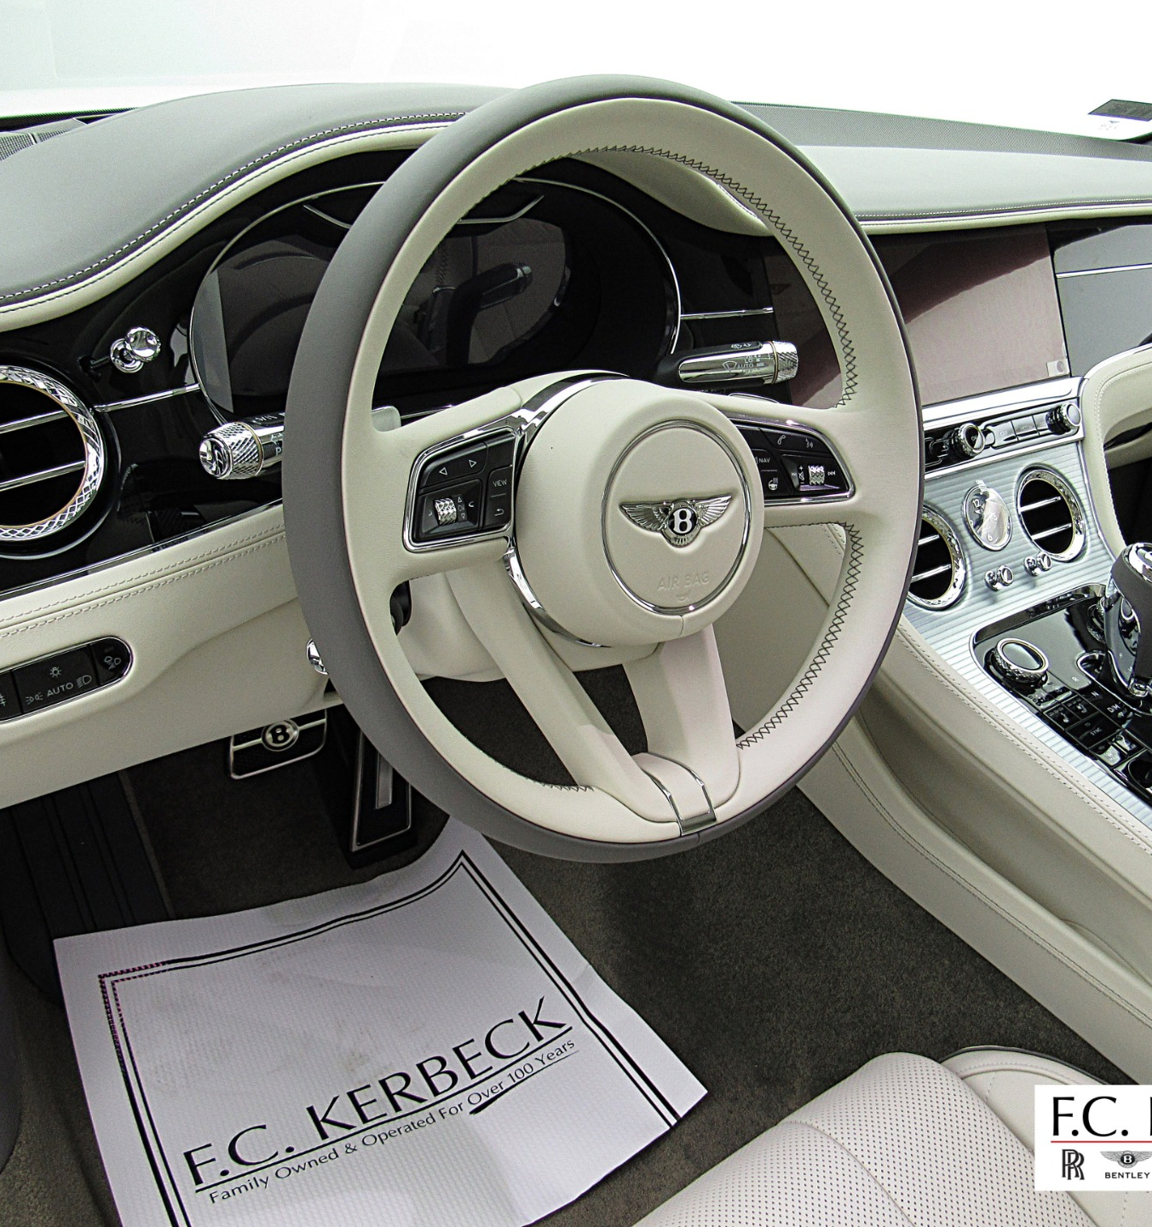
Describe features of the car, both seen and unseen, that minimise personal injury. Classify each feature as either A, B, C or D according to the principle/s it is employing.
The Bentley Continental GT has a lot of features. First off, there are several airbags that lessen the chance of an individual coming into touch with inside things. The knee area, A and B pillars, the steering wheel, and other places have several airbags. This is principle C. These improve airbag effectiveness and promote occupant safety within the vehicle. Second, the vehicle features a crumple zone in the front and a contemporary design. This is principle A. When the automobile crashes and there is an impact, it is cleverly constructed to absorb a significant amount of energy. Less energy reaches the passengers the more energy is absorbed by the frame and crumple zone. The automobile is safer as a result. The vehicle features several electrical systems, a specialised computer for the suspension and traction, and it is also low to the ground.

Slide 9
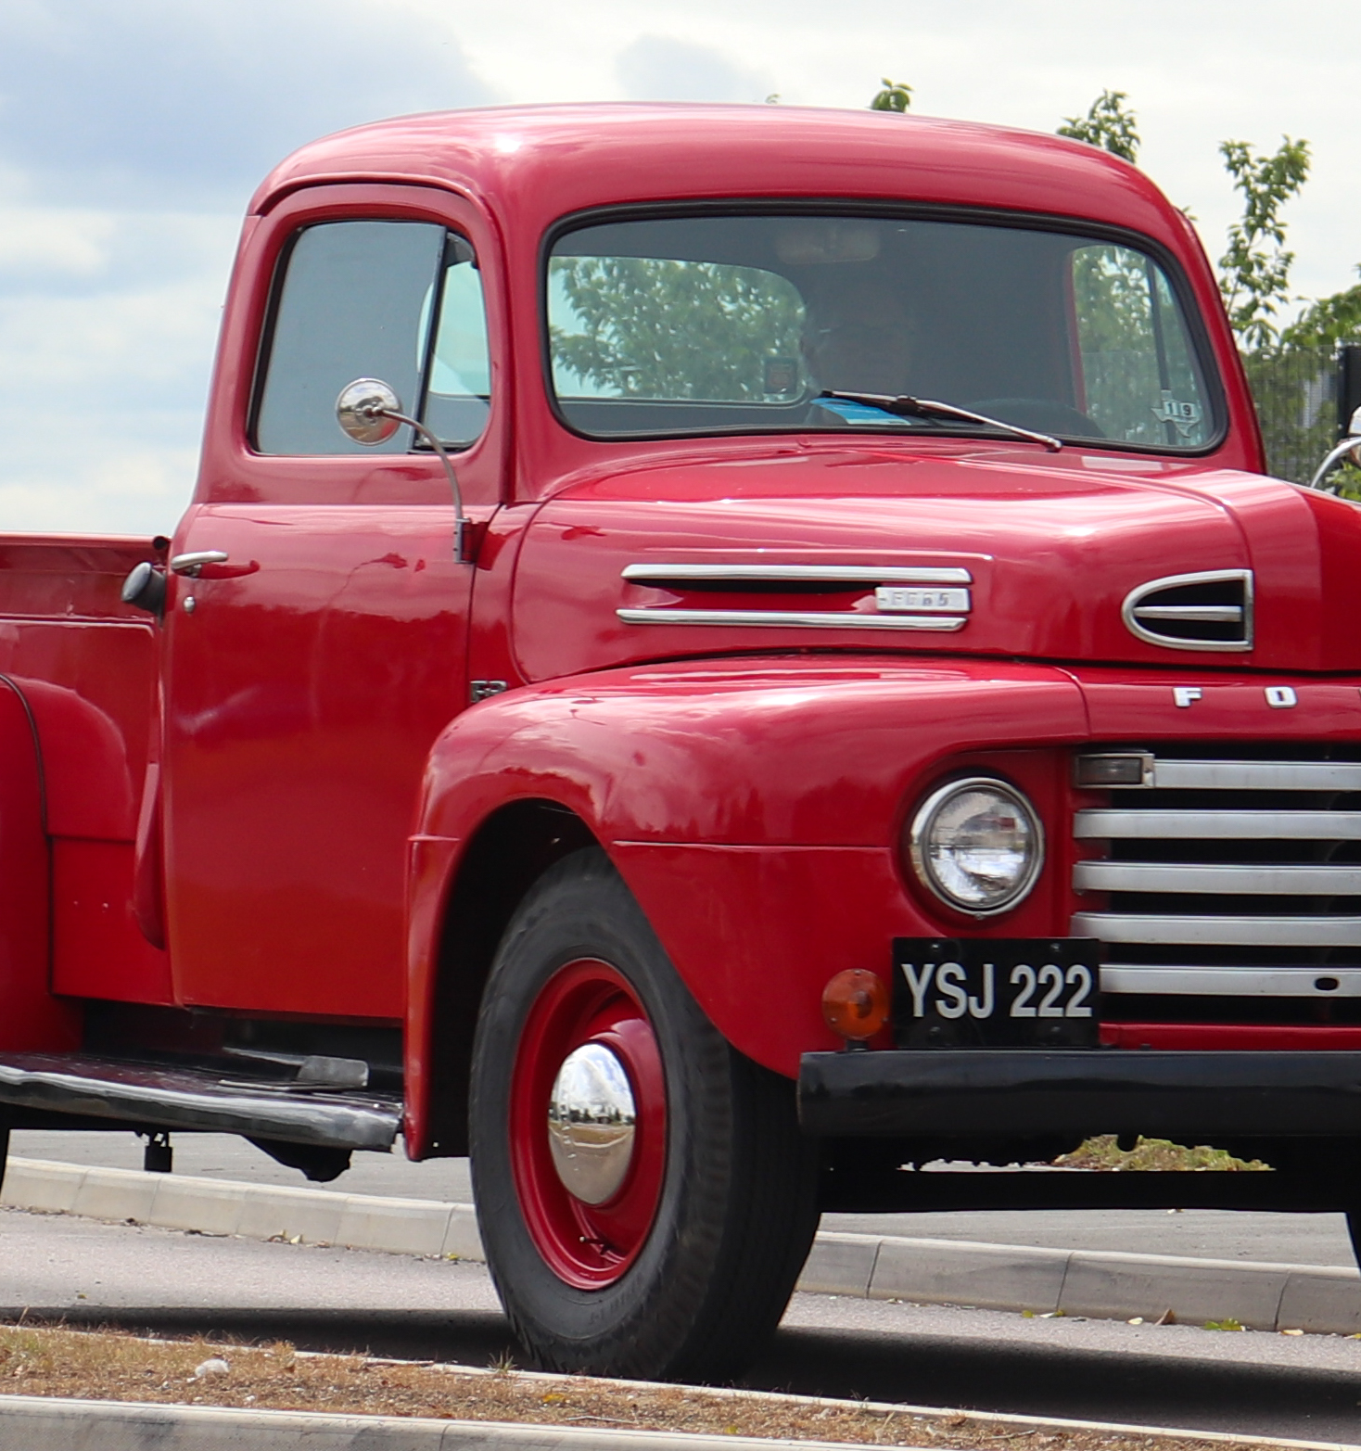
1950 Ford F1 Pickup
There are many aspects and deatures of this truck that make It very unsafe. For starters it has no crumple zone, and its design is very upright and boxy. The boxy design in all cars is very bad because boxy designs are not good at absorbing energy. A lot of the energy goes to the interior. The crumple zone absorbs a lot of energy and increases time of collision, Due to the lack of crumple zones and boxy design, the car isn’t good at absorbing energy and transfers a lot of it to the occupants. Furthermore, it there are no airbags and no seatbelts in this truck. If a crash happens you will fly out the window due to intertia and due to lack of airbags you will get injured when you hit the interior and its objects. It is very unsafe. Theres also the lack of safety systems like ABS, ETC, etc, so that makes the vehicle unstable and easy to lose control of.

Slide 10
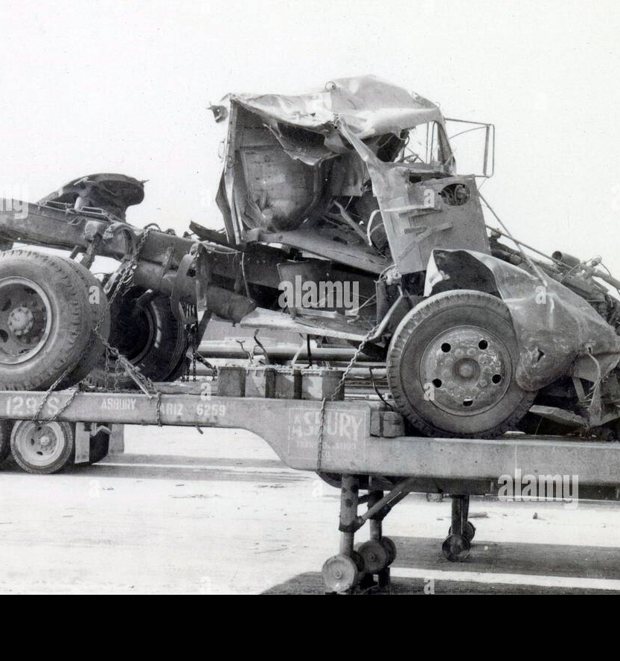
Classify each feature as either A, B, C, D according to the principle/s it is not employing, and which therefore makes it unsafe.
The lack of crumple zones results in the time taken for collsion to occur is less. This is related to impulse, and is principle A. quicker the impulse the more force the occupants will indure. The lack of airbags results in the occupants hitting the interior when there is a crash and getting injured. This is principle C. Seatbelts hold the occupants in place, the lack of seatbelts means the people inside will keep going the same speed of car even when the car has stopped due to inertia. This is principle D. Theres also the lack of safety systems like ABS, ETC, etc, so that makes the vehicle unstable and easy to lose control of. The truck is also high off the ground. This is example of principle B.

Slide 11
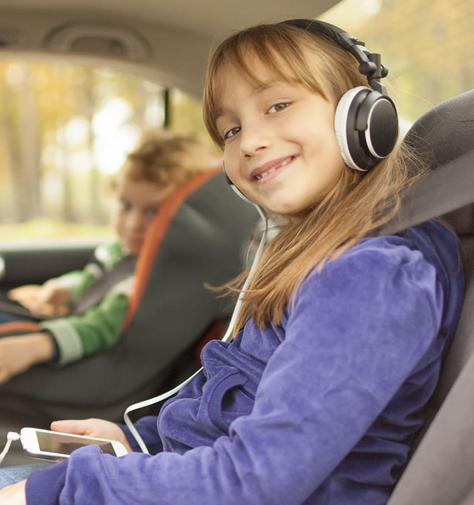
Summary
The development of automotive technology over the last few decades has created a positive image of the future of safer roadways. There are now safety systems that handle a wide range of potentially harmful circumstances, including as low visibility conditions, slick road surfaces, unintentional lane departure, and risky lateral swerving. Additionally, safety system designers keep upgrading current airbag and seat belt systems, including new whiplash prevention, and head protection designs in an effort to lessen injuries to passengers in cars during collisions. Additionally, as many safety features immediately compliment one another, they are frequently packaged and sold in strategic combinations. As a consequence, each safety element can contribute more to total vehicle safety than just what it can individually. y. For instance, drivers may spot possible road dangers earlier with adaptive headlights than they would without them. Drivers are better able to perceive hazards sooner and are more likely to be able to stop in time to prevent an accident if adaptive headlights and brake aid are used together. Similar methods in which electronic stability control (ESC) and anti-lock braking systems (ABS) work together.
Millions of more people every year get behind the wheel, and the more and more people there are, the likelihood of crashes happening increases. To combat this, newer vehicles should come with all the safety features possible, so they help reduce damage and reduce the chance of crashes happening in the first place.

Slide 12
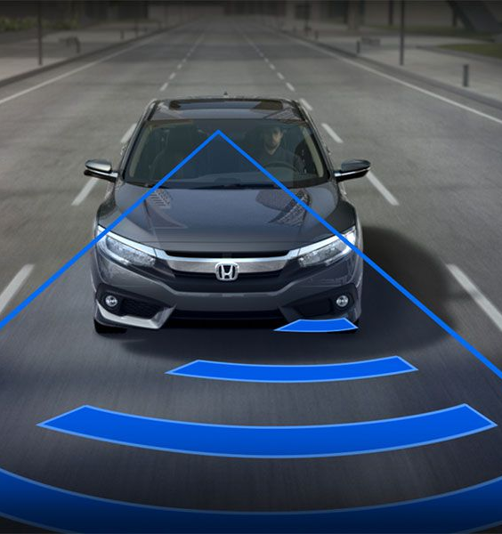
Suggested Improvements
There are many improvements for the design that can be made to make cars safer. A vintage or antique car's ability to be controlled and stop quickly will be drastically improved by installing contemporary disc brakes.Your antique or classic car may still have the original drum brakes that offer strong stopping force but need to be adjusted frequently as they deteriorate. Make sure your vehicle is equipped with current three-point seatbelts and that they are properly fastened. Airbags can be present and there can be airbags on the pillars and other areas to increase safety. Crumple zones can increase time of collision and improve energy absorbment of the car. It will be more safe for occupants. Frame of the car can be better designed and have space in the front rather than be boxy and have no front area. Radar and sensors can help reduce chance of crash, and can use cars systems to hve better control over car. The computers can best make the car’s suspension to adapt to road for better stability.

